Slide 1


Title:
Category:
Author:
Editor:
Update:
Audio: Links to C:\Audio MDA
Video: Links to C:\Audio MDA
Audio Calibration
(Right click icon, Play Sound)
Left Channel 74 dBA
Right Channel 74 dBA
Both Channels 80 dBA
Description:
Video Check
(Right click below, Play Movie)

Slide 2

Preparation Tips
Use Powerpoint to add interest (graphs, photos, audio, video)
NOT to add boredom or distraction
Do not use as lecture notes! No more than 25 words per slide i.e. Use bullet points - max 6 (3 to 4 words each). This slide is what NOT to do !!
Minimize use of fancy ‘fly ins’ - Use ‘Appear’ animation for multiple bullet points
Use ‘MDA Black’ slide template (Duplicate Slide 7, or go Format/Slide Design) to create contrast for pictures, videos etc
Revert to standard non-logo bulletpoint type by pressing TAB
Audio/Video
Powerpoint links to (rather than embeds) audio/video files greater than 100KB. Place any required audio/video files in “C:\Audio MDA” folder before you insert them. Create this folder on ANY computer you want to edit or present your presentation on.
You can use ‘embed’ for presentations with a small no. of audio/video samples (< 10mb total) that don’t require calibration. To embed you need to increase the ‘link file size limit’ (see Tools/Options/General) accordingly before insertion.
Presentation Tips
To start presentation, Press F5 or go to Slide Show/View Show.
Presentation will automatically start from your title page (Page 3)
You can black out the screen during presentation by hitting ‘B’ key.
Good when you are talking about something not on screen (‘B’ again to reappear)
To assist navigation, remember a few key slide nos.
Type 32 ‘enter’ to go to slide 32

Slide 3
Apartment Acoustics

Slide 4
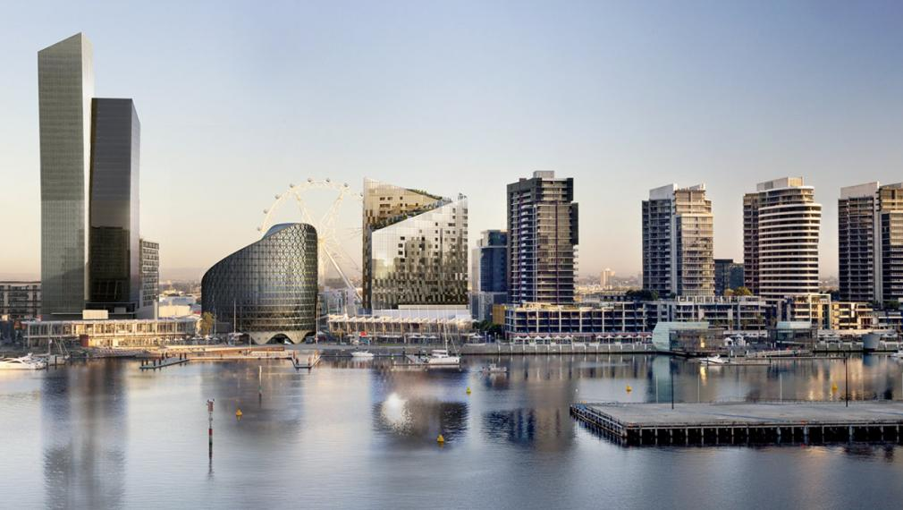
Apartment Buildings

Slide 5
Acoustic Design Criteria
Building Code of Australia:
Intertenancy walls and floors
Corridor walls and doors
Floor impact isolation
Lift, stair and core walls
Hydraulic services and risers
Electrical services and access panels
AS2107
Traffic and building services noise criteria
Other standards
AAAC Star Rating System
Green Star
Marketing and Body Corporate requirements
Planning permits and Planning Overlays

Slide 6
Walls and Doors
Airborne sound insulation
Inter-tenancy walls (R_{w}+C_{tr} 50)
Corridor walls (R_{w} 50)
Doors (R_{w} 30)
Lift, stair and core walls (R_{w} 50)
DISCONTINUOUS CONSTRUCTION!!!
Defined as a clear 20mm clear gap (not resilient mounts)
Wet areas adjacent to habitable (kitchens can be habitable or wet areas)
Required where hydraulic services located within wall
Required adjacent to lift shafts and plant rooms

Slide 7
Inter-tenancy walls
Building Code of Australia
Inter-tenancy walls (R_{w}+C_{tr} 50)
Corridor walls (R_{w} 50)
Doors (R_{w} 30)
Lift, stair and core walls (R_{w} 50)
DISCONTINUOUS CONSTRUCTION!!!
Defined as a clear 20mm clear gap (not resilient mounts)
Wet areas adjacent to habitable (kitchens can be habitable or wet areas)
Required where hydraulic services located within wall
Required adjacent to lift shafts and plant rooms

Slide 8
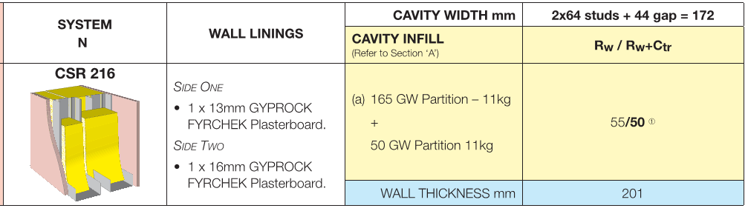
Inter-tenancy walls

Slide 9
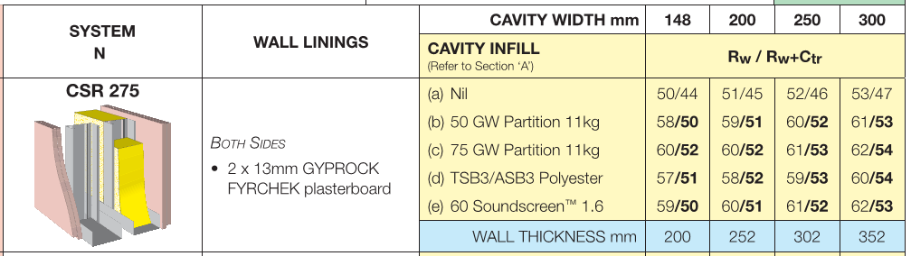
Inter-tenancy walls

Slide 10
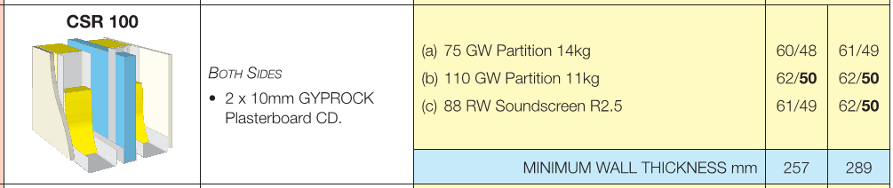
Inter-tenancy walls

Slide 11
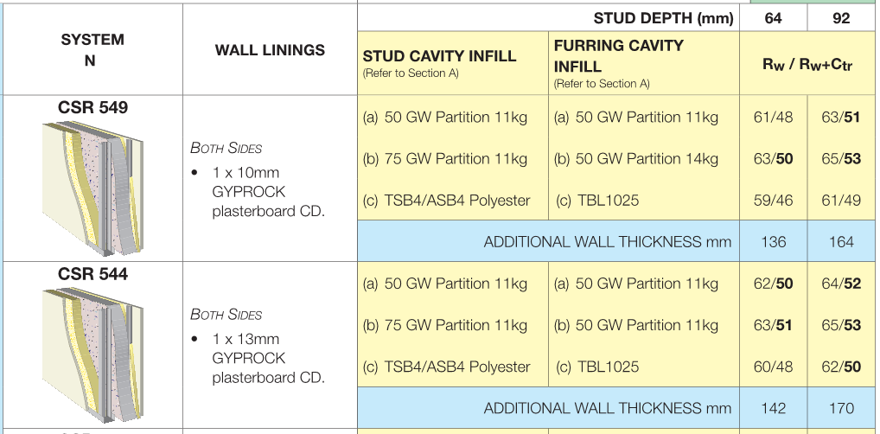
Inter-tenancy walls

Slide 12
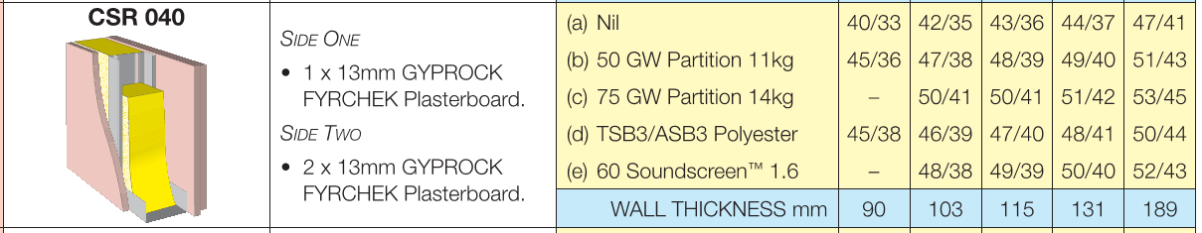
Corridor walls

Slide 13
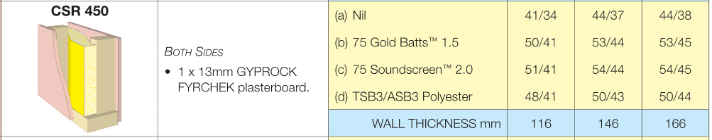
Corridor walls

Slide 14
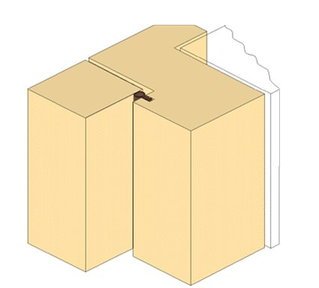
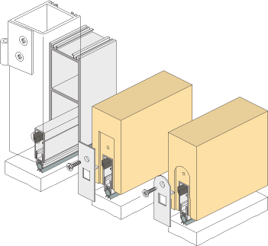
Doors
Frame seal RP 500
Frame seal RP 520
Drop seal RP 8

Slide 15
Lift and Plantroom walls
Minimum 200mm concrete
Apartment ceiling
Core
Apartment
13mm plasterboard
64mm stud with 50mm thick, 11kg/m³ insulation, 20mm clear gap from core wall

Slide 16
Floor/Ceiling systems
Airborne sound insulation
Inter-tenancy floors/ceilings (R_{w}+C_{tr} 50)
Minimum 200mm thick concrete with no ceiling
Concrete slabs can be thinner if suspended ceiling included
Concrete slabs less than 150mm will require ceiling cavity insulation
Light-weight construction requires great care
Floor Impact isolation
BCA criteria (L_{n,w}+C₁ < 62)
Minimum BCA Standard is poor and can be achieved by bare concrete
Minimum recommended L_{n,W} 55 (requires acoustic underlay)
Light-weight construction a big problem due to low frequency “thumps”

Slide 17
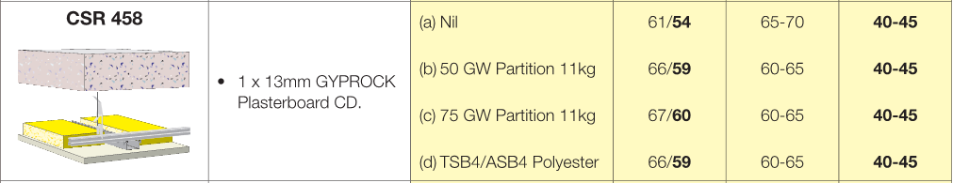
Floors

Slide 18
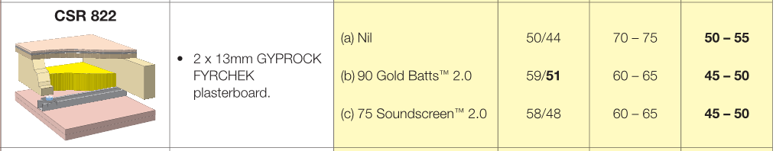
Floors

Slide 19
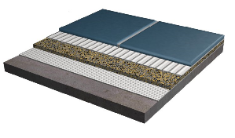
Resilient Underlay
(moderate performance)

Slide 20
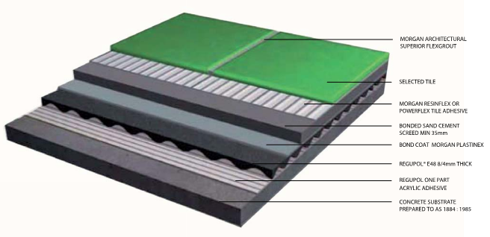
Resilient Underlay
(high performance)

Slide 21
Hydraulic Services
Acoustic separation
The BCA requires that hydraulic services pipes must be separated from the rooms of a sole-occupancy unit by construction with the following acoustic performance:
R_{w}+C_{tr} 40 if the room is a habitable room
R_{w}+C_{tr} 25 if the room is a non-habitable room (wet area)
The above requires the use of appropriate construction of ceilings and risers.
The acoustic performance of ceilings and risers can be reduced by the use if pipe lagging and acoustic insulation
Plastic water supply pipe also significantly reduces the required performance of risers and wall linings
Water supply pipes must technically be located within a cavity of discontinuous construction

Slide 22
Hydraulic Services - above ceilings
(habitable)
PVC/HDPE waste pipe wrapped with 1 layer of 25mm thick Soundlag 4525C, 4kg/m² acoustic pipe lagging or equivalent
13mm standard plasterboard ceiling, with all services penetrations to be acoustically sealed within 1200mm of pipe
Habitable room
75mm, 24kg/m³ acoustic insulation, 1200mm each side of pipe

Slide 23
Hydraulic Services - above ceilings
(wet area)
Acoustically lagged PVC/HDPE waste pipe
Full height wall lined on both sides
13mm plasterboard
50mm, 11kg/m³ acoustic insulation
(also required for FCU noise control. Permitted to stop and start around ceiling suspension system)
Standard single layer plasterboard ceiling (penetrations permitted)
Bathroom
Habitable room

Slide 24
Hydraulic Services – risers
(habitable)
PVC/HDPE waste pipe wrapped with
1 layer of 4kg/m² acoustic pipe lagging
2x13mm standard plasterboard fully sealed
50mm thick, 11kg/m³ cavity insulation
Riser
Habitable room
NOTE: Pipe access panels are not permitted

Slide 25
Hydraulic Services – risers
(wet area)
PVC/HDPE waste pipe wrapped with
1 layer of 4kg/m² acoustic pipe lagging
1x13mm standard plasterboard fully sealed
50mm thick, 11kg/m³ cavity insulation
Riser
Wet area
NOTE: Pipe access panels must be firmly fixed to overlap the frame by 10mm and be fitted with a sealing gasket along all edges, and must be constructed of 33mm particle board, or 9mm compressed cement sheet or other suitable material with a mass not less than 24.4kg/m²

Slide 26
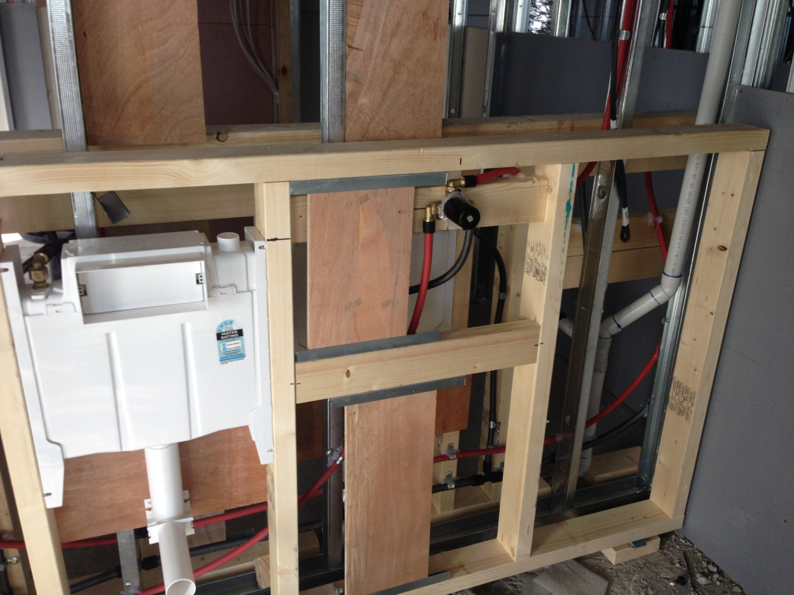
Hydraulic Services – Water Supply

Slide 27
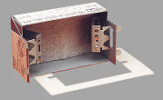
Electrical Services
BCA requires that when electrical outlets are mounetd within inter-tenancy walls:
They must be off-set from each other –
(A) in masonry walling, not less than 100mm
(B) in timber or steel framed walling, not less than 300mm
If the above cannot be achieved, then an acoustically rated electrical wall box can be installed to allow back-to-back installation.

Slide 28
External sound insulation
No applicable BCA criteria (yet!!)
AS2107 provides recommended noise levels for building interiors
Higher quality usually requires lower noise levels
Some danger in making rooms too quiet
Double glazing not always better.
Single laminated glass often preferred due to better low frequency performance
Window seals critical
Awning windows better than sliding or sash windows
Treatment to ventilation paths and facade construction also important
Wintergardens required in extreme circumstances

Slide 29
Building Services
No applicable BCA criteria
AS2107 provides recommended noise levels for building interiors
Environmental noise emissions must comply with EPA Guidelines and Stage Government Legislation
Ducted ceiling mounted units require careful design
Toilet and kitchen exhaust fans ducted to facade
External condensing units require screening
Central plant such as car park exhaust fans may need silencers

Slide 30
Other considerations
Site Inspections
Vibration
Acoustic sealing of penetrations
Balconies/Terraces
Garbage chutes
Carparks and garage doors
Junction details critical
Building isolation to control vibration is near railway lines etc
Swimming pools and associated plant require isolation
Gymnasiums
Lobby acoustics (reverberation)
Mixed-use – cafeterias, retail or commercial interface
Existing commercial neighbours
Existing entertainment venues

